Slide 1
A Guided Self-Help Intervention for College Women with Eating Disorders: Long-term Results from a Large Randomized Control Trial
C. Barr Taylor, Ellen E. Fitzsimmons-Craft, Mickey Trockel, Grace E. Monterubi, Neha J. Goel, Shiri Sadeh-Sharvit, Katherine N. Balantekin, Dawn M. Eichen, Rachael E. Flatt,Marie-Laure Firebaugh, Corinna Jacobi, Andrea K. Graham, Burkhardt Funk, Denise E. Wilfley

Slide 2
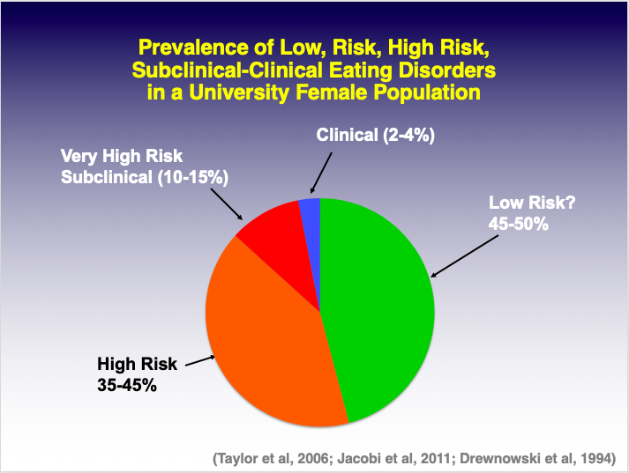
Notes:
Taylor et al, Arch Gen
Psych 2006, 63;831
Jacobi et al, Psych Med,
31;1; 2011
Drewnowski et al, Am J
Psych, 1994;151;1217

Slide 3
Healthy Body Image/NIMH Screen
Screening Algorithm: Stanford-Washington University ED Screen
Low risk for ED
WCS < 45
Screen --
High risk for ED
WCS > 47
ED screen --
Clinical ED (DSM V)
No AN
Stable
No SI
Clinical ED (DSM V)
Possible AN
Unstable
No SI
Offered universal
Healthy weight regulation/body
Image program
(StayingFit)*
Offered on-line targeted
ED prevention
Program
(StudentBodies)
Treatment recommended:
*Offered indicated
ED RX Program
(Lantern or EB-ED based on iCare)
Referral for In- person eval, rx
Notes:
Add visual

Slide 4
Research Aims:
To determine the efficacy of an on-line guided intervention to treat
eating disorders among college and university age females.

Slide 5
Design:
28 colleges and universities randomized (by site) trial.
- Up to 2 year follow-up
- Recruitment occurred over the course of three years

Slide 6
Recruitment:
using campus-specific recruitment strategies
  electronic media (e.g., email),
  printed materials (e.g., flyers),
  presentations,
  social media,
  peer health educators/counselors
Notes:
, developed collaboratively with campus stakeholders (e.g., identified HBI liaison in the counseling/health center—typically a counselor),

Slide 7
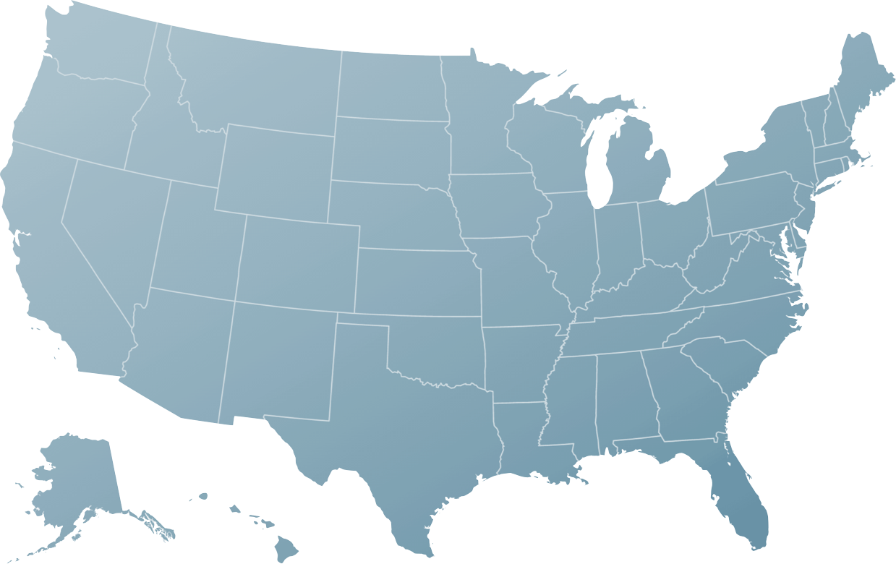
HBI schools
Notes:
Add visual

Slide 8
Measures:
Main outcome measures:
- Overall eating pathology (Eating Disorder Inventory—total score)
- Depression (PhQ-9)
- Anxiety (PROMIS)
- Abstinence (Eating Disorder Examination)
- Clinical impairment (as measured by the CIA)
Other measures (not yet analyzed):
- Treatment uptake
- Academic impairment

Slide 9
Intervention:
CBT program, derived from manualized program
Targets key ED pathology:
- Extreme dietary restraint
- Overvaluation of shape and weight
- Binge eating
- Compensatory behaviors
Focuses on:
- Regular eating
- Self-control strategies
- Problem Solving
- Relapse prevention/maintenance

Slide 10
Intervention:
40 sessions, over six months, organized as 9 themes
Coached (via texts, optional one phone call)
Note: program was changed after year one from weekly paced, to self-paced

Slide 11

Notes:
We saw this coming over the course of the trial

Slide 12
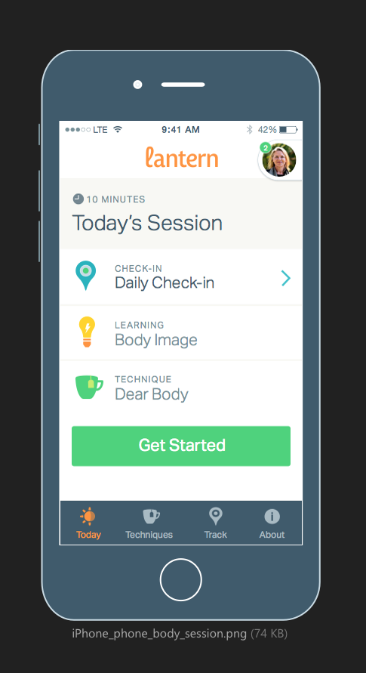
Notes:
We saw this coming over the course of the trial

Slide 14
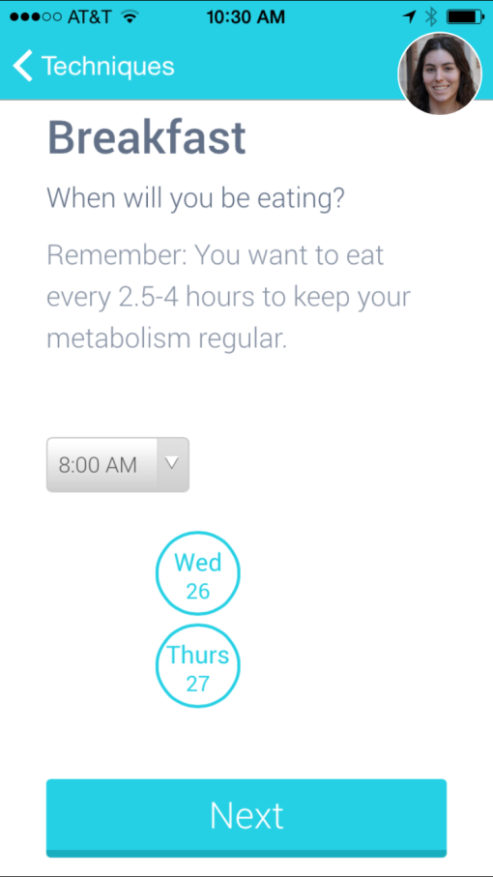
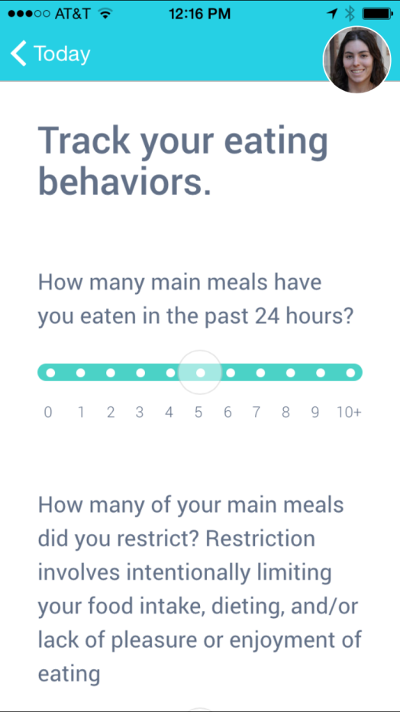
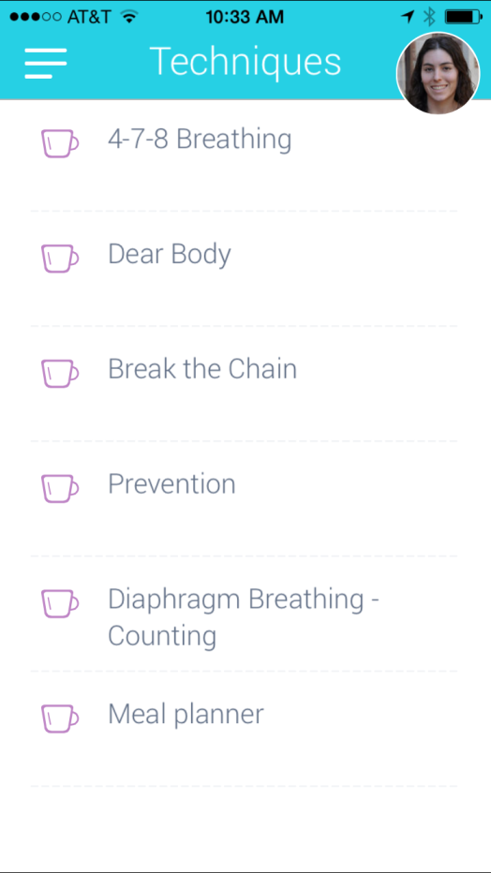
Meal Planning
Tools
Self-Monitoring
Logs
Tool
Dashboard
Notes:
We saw this coming over the course of the trial

Slide 15
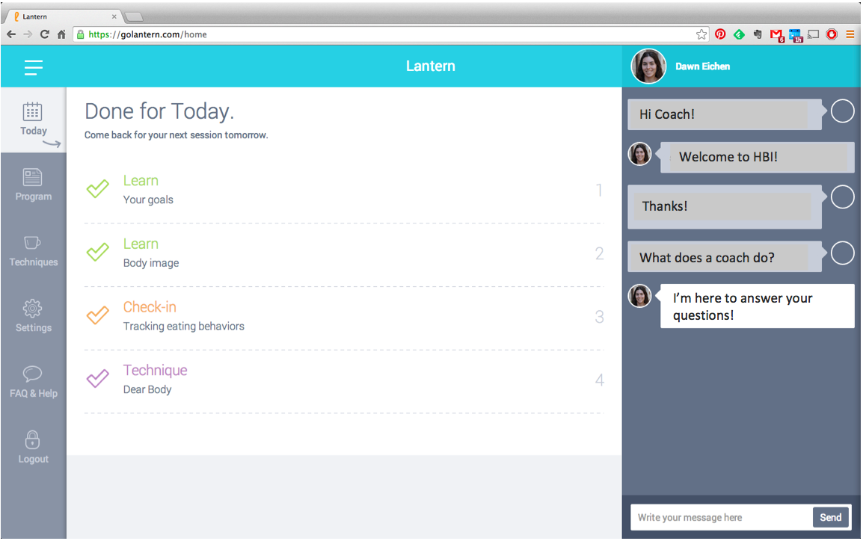
Coach Messaging
Notes:
We saw this coming over the course of the trial

Slide 16
Data Analysis:
Intention to treat
Mixed models for continuous variables

Slide 17
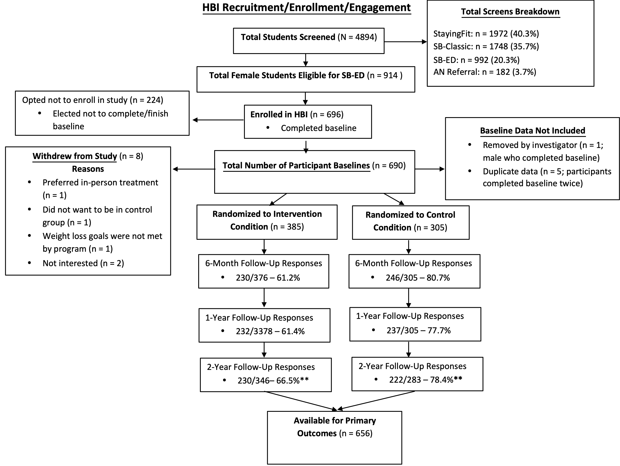
Results:

Slide 18
Adherence:
Year 1 (N =125)
17% complete
SD 31
Median 3
Years 2 an 3 (N – 238)
39 % complete
SD 38
Median 20

Slide 19
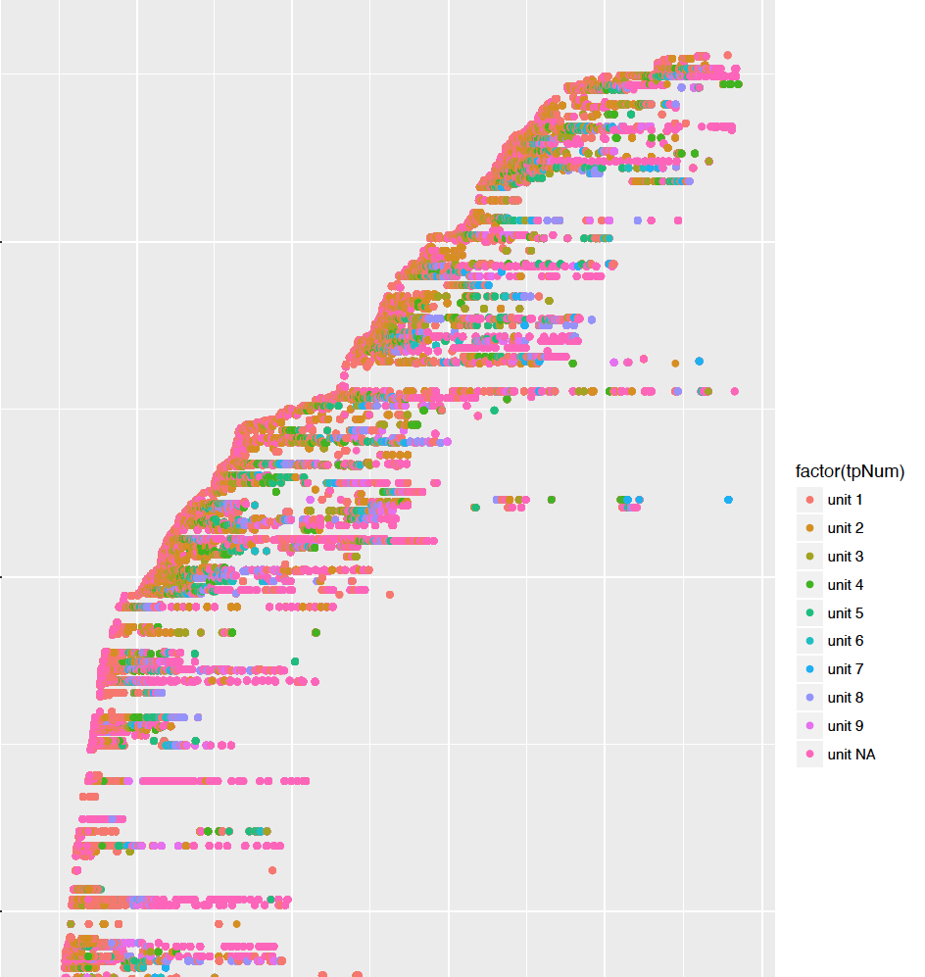
Years 2 & 3 Adherence
(units = components in the program)

Slide 20
Results
Notes:
1 – baselkne
2 is six months
3 is one year
4 is two years

Slide 21
Results

Slide 22
Results

Slide 23
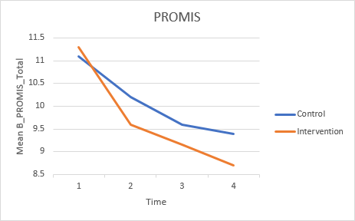
Results

Slide 24
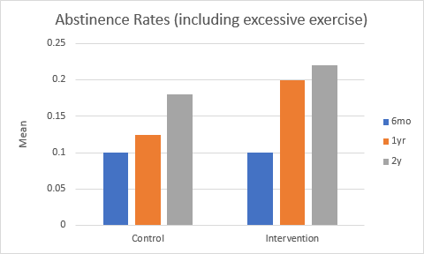
Results

Slide 25
Summary
An on-line, coached eating disorder program significantly reduced:
eating disorder pathology,
clinical Impairment and
depression
Long-term abstinence rates were lower than expected, suggesting program efficacy could be improved
Contribution of “realized therapy” (e.g. also seeing face-to-face and other sources), TBD
Effects of academic performance TBC
Notes:
We saw this coming over the course of the trial

Slide 26
Summary
Program was very inexpensive: $40/month
but no longer available (😒)
Notes:
We saw this coming over the course of the trial

Slide 27
Implications/Conclusions:
Coached on-line programs can be effective
Adherence/engagement needs to be improved

