Slide 1
Harnessing Technology for Screening and Intervention with Eating Disorders on College Campuses
Long-term outcomes from a cluster randomized trial and future directions
Denise E. Wilfley, PhD & Ellen E. Fitzsimmons-Craft, PhD
Notes:
The proposal bridges our team’s work implementing population-based screening in >160 colleges and demonstrating the effectiveness of online/mobile interventions for anxiety, depression, and EDs in >40 colleges.

Slide 2
Our Team
Principal Investigators
Denise Wilfley pHD
Shiri Sadeh-Sharvit PhD
Grace monterubio ma
Andrea Graham Phd
Katherine Balantekin PhD, RD
Dawn Eichen PhD
C. Barr Taylor MD
Neha goel ba
Rachael Flatt BS
Anna karam ma
Marie-Laure Firebaugh LMSW
Booil jo
phd
Mickey trockel md, phd

Slide 3
The problem of Eating disorders on college campuses
Eating disorders (EDs) are common in college women
Yet, less than 20% of students who screen positive for an ED report receiving treatment
Delays in treatment result in prolonged illness, disease progression, poorer prognosis, and greater likelihood of relapse
Eisenberg et al., 2011, J Am Coll Health; Fitzsimmons-Craft et al, in press, Curr Psychiatry Rep; Kazdin et al., 2017, Int J Eat Disord
Notes:
College women are at high risk of facing eating and weight concerns.
An estimated 8-17% U.S. college women experience an eating disorder.
Many do not meet full criteria, but show high body dissatisfaction
34% of undergraduate females reported that they believe themselves to be fat even though others say they are thin.
Yet, very few receive any help to address their shape and weight concerns. Less than 20% of students who screen positive for an ED report receiving any treatment
This treatment gap is a serious problem because delays in treatment result in prolonged illness, disease progression, poorer prognosis, and greater likelihood of relapse.

Slide 4
Limited access to care
Screening
Only 22% of colleges offer year-round ED screening opportunities
Offered screenings only reach a small number of students
Treatment
Counseling centers have limited capacity to treat students
Average student-to-counselor ratio is 1,731:1
Lack of access to evidence-based treatments
Opportunities for improved screening, prevention, and treatment of EDs on college campuses are greatly needed
Eisenberg et al., 2011, J Nerv Ment Dis; Eisenberg et al., 2012, J Am Coll Health; National Eating Disorders Association, 2013
Notes:
Resources for detecting and treating EDs on college campuses are limited, even though it is one of the most prevalent mental health disorders in students (Eisenberg et al., 2011).
Even when mental health screening is offered on college campuses, available data suggest that reach is limited (e.g., completed by 8% of students invited by email in one study; Haas et al., 2008).
Current treatment delivery efforts for EDs on college campuses are hindered by such factors as limited counseling center capacity, as evidenced by high student to counselor ratios and inadequate access to evidence-based treatments (AUCCD, 2016, Mowbray et al., 2006; Waller, 2016; Xiao et al., 2017)
Eisenberg et al. (2011) found 32% of sample to have a mental health problem. This means that of the 1,731 students per counselor, roughly 550 may have a mental health disorder.
From 2009-2014, 88% of college counseling centers reported an increase in the number of students seeking treatment; one study found that the number of appointments made increased by 30% during this timeframe (Xiao et al., 2017, Psychol Serv)
Opportunities for improved screening, prevention, and treatment of EDs on college campuses are greatly needed.

Slide 5
Barriers to Care
“I don’t need treatment.”
“I prefer to handle issues on my own.”
“Stress is normal in college.”
“I don’t have time.”
“I am concerned about confidentiality/ privacy.”
“I’m worried about stigma.”
Eisenberg, et al., 2007, Medical Care; Hunt & Eisenberg, 2010, J Adolesc Health; Reetz et al., 2015, AUCCCD
Notes:
Using data from the Healthy Minds Survey, an online survey of college students conducted 2007-2009, Eisenberg et al. looked at barriers to care in those with untreated mental health problems. The primary reason for not seeking treatment was not recognizing that treatment was warranted, followed by low urgency to seek services (students responded that they “prefer to handle issues on my own” and “stress is normal in college.” Additionally, students cited lack of time, privacy concerns and stigma as reasons they did not seek care. (Eisenberg et al., 2012).
Important to note that a majority of students (65%) reported low stigma and positive attitudes towards mental health treatment, among both those who self-identified as needing treatment and those who did not.
This demonstrates an encouraging openness towards treatment, emphasizing the need for a more efficient, proactive, and accessible service delivery model for managing mental health in college student populations for combined targeted prevention and intervention
We need novel ways to increase access to screening and care

Slide 6
Potential for mobile technology
Mobile and Internet-based technologies have the potential to improve care for EDs on college campuses by overcoming barriers
Technology can:
Improve student treatment engagement with convenient and anonymous format
Offset in-person clinical demands
Reduce costs
Increase reach of screening and access to care
Beintner et al., 2012, Eur Eat Disord Rev; Jones et al., 2014, J Am Coll Health; Kass et al., 2017, Int J Eat Disord; Kazdin, Fitzsimmons-Craft, & Wilfley, 2017, Int J Eat Disord

Slide 7
Healthy Body Image (HBI) Program
To address the problem of EDs on college campuses, we developed an online platform for:
1. Universal screening
2. Tailored, evidence-based prevention and intervention
Goal: Reduce the incidence and prevalence of EDs
Jones et al., 2014, J Am Coll Health; Wilfley et al., 2013, Int J Eat Disord; R01 MH100455; PIs Wilfley & Taylor
Notes:
To meet this need, we developed an online platform for screening and delivering tailored interventions to a population of individuals with varying ED risk and symptom profiles via system-level implementation on college campuses.
Overall goal: reduce the incidence and prevalence of eating disorders
Can be tailored to each school, increasing acceptability
The Healthy Body Image Program is a comprehensive online, evidence-based program developed and evaluated by Stanford and Washington Universities to enhance body image and promote healthy lifestyles among students. It:
Identifies at-risk and symptomatic students
Improves body image and reduce weight/shape concerns
Facilitates healthy weight regulation
Reduces risk for and symptoms of eating disorders
Reduces barriers to treatment
Overall goal: reduce the incidence and prevalence of eating disorders
Can be tailored to each school, increasing acceptability

Slide 8
HBI Screening Algorithm
Stanford-Washington University Eating Disorders Screen
Low Risk
Screen negative for EDs or elevated risk status
High Risk
Screen negative for EDs but positive for elevated risk
Clinical/Subclinical
Screen positive for ED (other than AN)
Possible Anorexia Nervosa (AN)
Screen positive for AN
Staying Fit
Student Bodies- Classic
Student Bodies- Eating Disorders
Referral to counseling center
Students are offered a personalized, evidence-based, cognitive-behavioral therapy (CBT)-based HBI program or referred to resources, based on their level of risk or symptoms
Once enrolled, students access their intervention via web or mobile app
8
Notes:
Students are offered a personalized, empirically-supported, cognitive-behavioral therapy (CBT)-based HBI program or referred to resources, based on their level of risk or symptoms
Once enrolled, students access their intervention via web or mobile app

Slide 9
HBI: The Current study
1
2
Primary aim
Secondary aims
Test the hypothesis that Student Bodies-Eating Disorders (SB-ED) would significantly improve ED psychopathology compared to referral to usual care among college women with EDs
Test the hypotheses that SB-ED, compared to referral usual care, would:
Reduce ED behaviors (i.e., binge eating and compensatory behaviors), depression, anxiety, and ED-associated clinical impairment
Increase realized treatment access
Notes:
The aim of the current study was to test the hypothesis that a digital cognitive-behavioral therapy (CBT) guided self-help program, Student Bodies-EDs (SB-ED), would improve ED psychopathology in college women screening positive for a DSM-5 (DSM-5 citation) ED (other than anorexia nervosa, for which more intensive medical monitoring is often warranted) compared to referral to usual care. Secondary aims were to test the hypotheses that SB-ED, compared to referral usual care, would increase abstinence rates, reduce ED behaviors (i.e., binge eating and compensatory behaviors), depression, anxiety, ED-associated clinical impairment, and increase realized treatment access.

Slide 10
HBI: Design
Randomized 28 universities across the U.S. to receive SB-ED or referral to care as usual
All schools had access to Staying Fit and Student Bodies-Classic for students at low and high risk, respectively
Recruitment over the course of 3 years
Assessment timeline for females with EDs who were randomized:
Baseline
1-Year Follow-Up
2-Year Follow-Up
Post Intervention

Slide 11
Intervention: sb-ed
Guided intervention
Format
CBT program that targets key ED pathology:
Each user assigned a personal coach to guide them through the intervention
9 online modules
Year 1: One session per week
Year 2 & 3: 40 brief daily sessions
Extreme dietary restraint
Over-evaluation of shape and weight
Binge eating
Compensatory behaviors
Delivered on a platform hosted by the technology company, Lantern
Notes:
Each user had access to the 9 online modules of the intervention for 8 months. During year 1, when the platform was hosted by technology company, Lantern, users completed one hour-long session per week. During year 2, the platform was hosted by a different eHealth technology company, Minddistrict, and revised to comprise 40 brief daily sessions that can be complete on a computer or an iPhone mobile app.
We created a mobile platform based on feedback from previous studies to improve participant engagement and reduce dropout rates.
A recently published review of technology-based interventions for EDs found that none of the eTherapy programs were available through a mobile application, highlighting the need for digital developers to capitalize on smartphone features (Barakat et al., 2019).

Slide 12
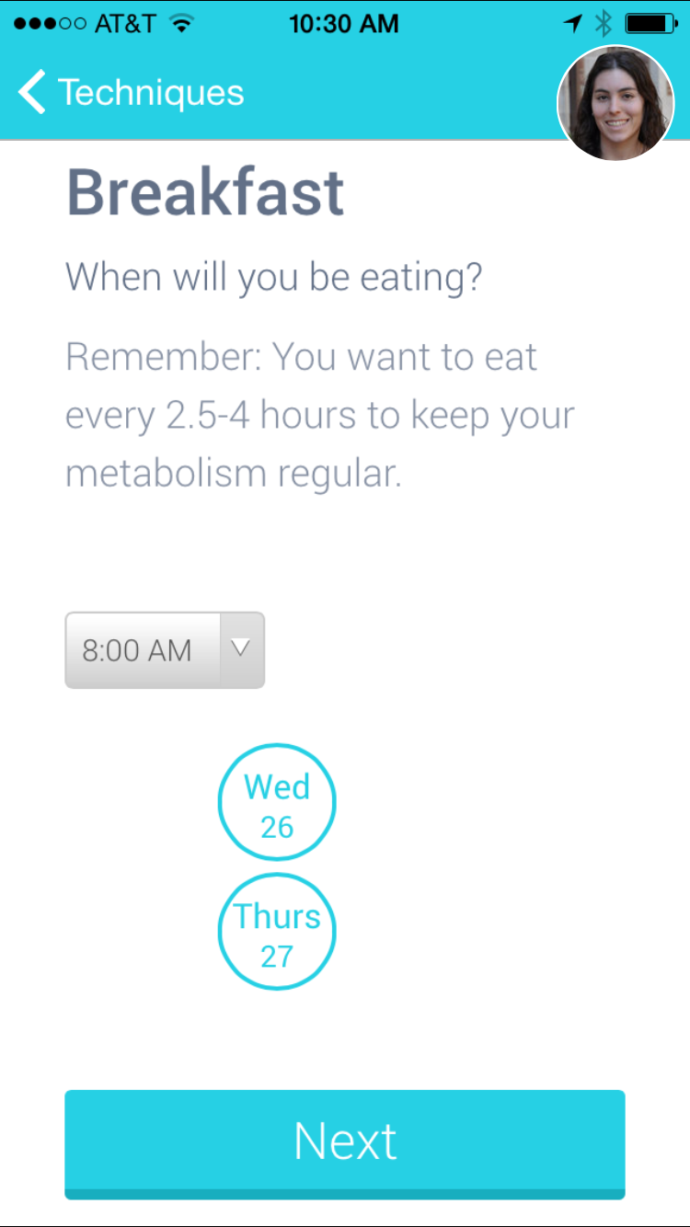
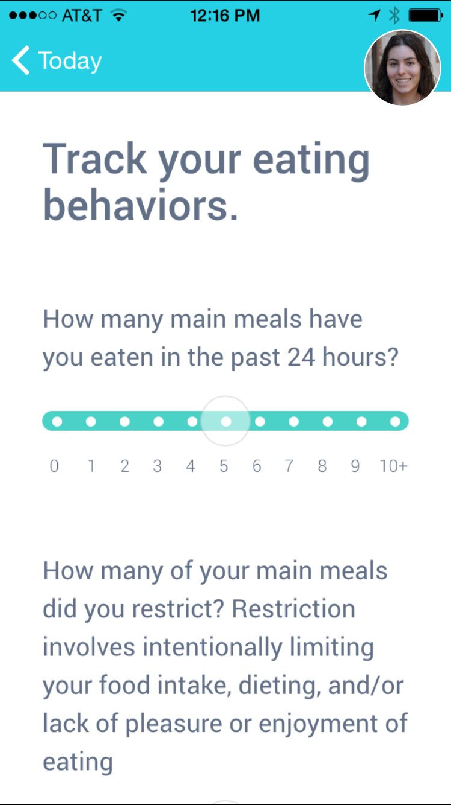
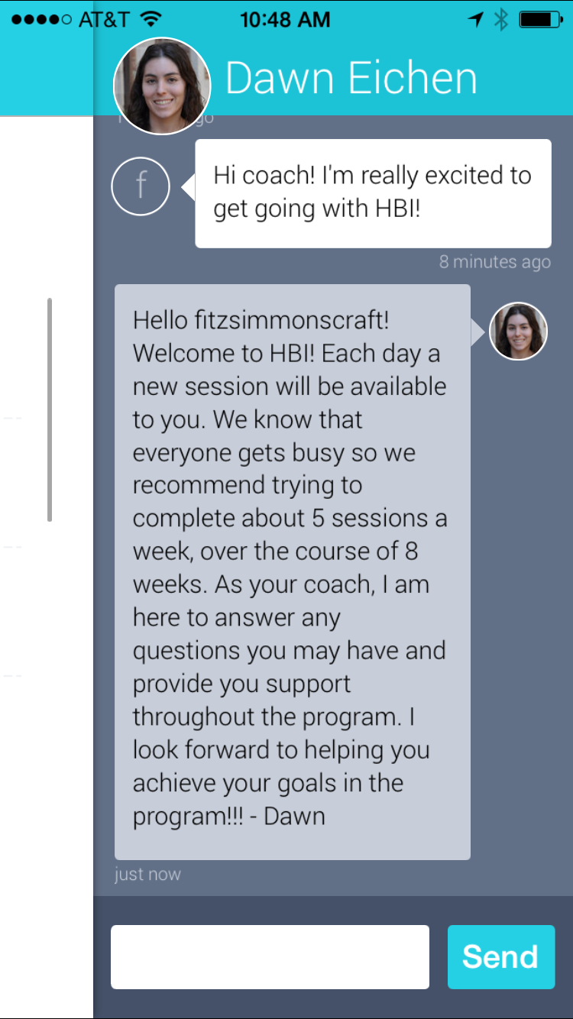
Intervention: SB-ED
Meal planning & tracking tools
Self-monitoring logs
Psychoeducational content
Coach messaging
Notes:
Focuses on
Regular eating
Self-control strategies
Problem solving
Relapse prevention/maintenance

Slide 13
participants
N=690; Intervention: n=385, Control: n=305
Age: 22.1 (SD=4.8)
74% undergraduate
Race: 60.0% White, 17.1% Asian, 5.4% Black/African American, 14.5% other/ multiracial
Ethnicity: 17.4% Hispanic
BMI: 25.7 (SD=6.02)
Notes:
The screen was completed 4,894 times, with an average of 1.9% of the
undergraduate female student body on each campus taking the screen.

Slide 14
Analytic Strategy
Mixed effects models were used to account for the nested structure of multiple assessment points for each individual participant, nested within university groups
Rendered intent to treat analysis estimates of:
Intervention effects on change between baseline and post
Intervention effects on change between baseline and long-term follow-up (averaged across 1- and 2-year follow-ups)
Notes:
We assessed time by intervention interaction effects for each outcome variable
Cuts type 1 error rate in half.
Increases statistical power.
Improves adherence to "intent to treat" principles, in that model information is derived from all available data and "follow up" efficacy is assessed via the average of two time points rather than a single time point, which helps with a reasonable estimate for participants who only complete one follow-up assessment.
From Using Tech draft: The power analysis was based on the primary hypothesis testing (i.e., to determine effects of the intervention compared to control on EDE-Q Global Score) at post-intervention. The power calculation took into account that cluster randomization occurred at the university level, and that we assumed there would be, on average, 25 students eligible per university. Under this scenario, we assumed intra class correlation (ICC) 0.05 to 0.15. With little prior information on effect size of our primary hypothesis, we assumed a medium effect size (Cohen’s d = 0.5) at post-intervention in our power estimation. The estimated power ranged from 0.85 to 0.99 with the total of 26 universities (13 universities per condition, 25 students per university) for a total sample of 650 students. We used multilevel mixed effects modeling as a main statistical strategy to conduct the analysis of primary and secondary study aims including data from all participants in line with the intent-to-treat principle. Random effects were specified to account for the nested data structure of multiple assessment time points (level 1) within individual participants (level 2), and multiple individuals within each university site (level 3). Fixed effects were specified to contrast (i.e., to estimate change) post-intervention assessment with baseline assessment and to contrast overall follow-up assessment (combining one- and two-year follow-up assessments) with baseline assessment. Level 3 fixed effects were specified for the intervention effects (i.e., intervention versus control) accounting for randomization at the university site level. For analyses regarding academic impairment (due to the very small numbers of students reporting withdrawing from courses/taking leaves of absence due to eating related concerns), Fisher’s exact tests were used to compare these outcomes across conditions at each assessment.

Slide 15
MAIN OUTCOME: ED PSYCHOPATHOLOGY
Post: t-ratio=-4.22, p<0.001, d=-0.40
Follow-up: t-ratio=-3.25, p<0.001, d=-0.35
Notes:
Compared to control group participants, intervention group participants’ EDEQ global scores decreased by 0.44 points (d = -0.40) more between baseline and post-test assessment. Intervention group participants’ EDEQ global score reductions were still 0.39 points (d = -0.35) greater during long-term follow-up assessment, on average.

Slide 16
Secondary outcomes: ED BEHAVIOR FREQUENCIES
EDE-Q Binge Frequency
EDE-Q Compensatory Behavior Frequency (vomiting, laxative use, and excessive exercise)
For binge eating frequency, significantly lower rates in intervention at post (p=0.016) but not over follow-up period (p=0.053)
For overall combined compensatory behavior frequency, significantly lower rates in intervention at post (p<0.001) and over follow-up period (p=0.035)
Notes:
For binge eating frequency, there were significantly lower rates in the intervention compared to the control group at post-intervention (Rate: 0.82 [0.70-0.96]; p = 0.016) but not over the follow-up period (Rate: 0.81 [0.65-1.00]; p = 0.053). For overall combined compensatory behavior frequency, there were significantly lower rates in the intervention compared to the control group at post-intervention (Rate: 0.68 [0.54-0.86]; p < 0.001) and over the follow-up period (Rate: 0.76 [0.60-0.98]; p = .035).
vomiting, laxative use, and excessive exercise.

Slide 17
Secondary outcomes: Clinical impairment
Post: t-ratio=-2.55, p=0.011, d=-0.21
Follow-up: t-ratio=-2.93, p= 0.003, d=-0.28

Slide 18
Secondary outcomes: DEPRESSION AND ANXIETY
Depression (Patient Health Questionaire-9 [PHQ-9])
Anxiety (Patient Reported Outcomes Measurement Information System [PROMIS] Anxiety Short Form)
Moderate
Mild
The intervention was associated with significantly greater reductions in depression at post (p=0.009, d=-0.22) and over the follow-up period (p=0.003, d=-0.21)
There was not a significant difference at post (p=0.055, d=-0.16) but the difference over the follow-up period was significant in favor of the intervention (p=0.008, d=-0.20)
Kroenke et al., 2011, J Gen Intern Med
Notes:
The intervention was also associated with significant reductions in depression at post-intervention and over the follow-up period compared to the control group, as well as with significant reductions in anxiety over the follow-up period compared to the control group
0-4 “no signs of depression”, 5-9 “mild depression”, 10-14 “moderate depression”, 15-19 “moderately severe depression”, and 20-27 “severe depression”.

Slide 19
Secondary outcomes: realized treatment access
Odds of engagement with some form of ED-related intervention were over 12 times greater for intervention group participants
OR=12.4; 95% CI=8.73-17.5; p<0.001
Notes:
“Have you had any treatment for eating related problems in the last [number adjusted based on time between assessments] months?”

Slide 20
Intervention engagement
Among intervention participants, percent engagement with the program was significantly associated with greater decreases in EDE-Q Global scores from baseline to post (p<0.001)
Notes:
Regarding intervention engagement, among those who created an account (n = 363), on average, participants completed 31% (SD = 37) of the session content offered. For Year 1 participants, engagement was 17% (SD = 31) and for Years 2 and 3 it was 39% (SD = 3
Only 12% of those who created an account did not engage with any program content.
8).

Slide 21
summary
A mobile, coached ED program significantly reduced:
Overall ED psychopathology
Effect size in line with meta-analytic findings on the efficacy of in-person CBT vs. inactive control on cognitive symptoms in patients with BN and BED (Hedge’s g = 0.24-0.34)
Effect size similar to other RCTs of online interventions for EDs and other psychiatric disorders
Binge eating and compensatory behaviors
Clinical impairment
Depression
Gains sustained through follow-up for all outcomes except binge eating
Linardon et al., 2017, J Consult Clin Psychol; Linardon, 2018, Int J Eat Disord; Linardon & Wade, 2018, Int J Eat Disord; Melioli et al., 2016, Int J Eat Disord; Mond et al., 2004, Behav Res Ther; Taylor et al., 2019, under review
Notes:
Also – effect sizes for EDE-Q Global in line with meta-analytic findings on the effect of therapist-led CBT vs. inactive control on cognitive symptoms (e.g., EDE-Q Global) in patients with BN and BED (Hedge’s g=.24-.34)

Slide 22
Gaps remain
Despite the success of HBI, there is much work that needs to be done to optimize outcomes for individuals with EDs
Screens do not reach all of those in need
Treatment and research-practice gaps remains extremely wide → need for range of available evidence-based intervention options
The number of individuals who follow through on treatment recommendations after a screen is suboptimal
Among those who do receive treatment, many individuals fail to complete a full course of treatment or achieve a desired outcome within a set timeframe
Taylor et al, in press, Int J Eat Disord
Notes:
Also – effect sizes for EDE-Q Global in line with meta-analytic findings on the effect of therapist-led CBT vs. inactive control on cognitive symptoms (e.g., EDE-Q Global) in patients with BN and BED (Hedge’s g=.24-.34)
The screen was completed 4,894 times, with an average of 1.9% of the
undergraduate female student body on each campus taking the screen. ED risk in participating
students was high—nearly 60% of students screened were identified as
being at high risk for ED onset or having an ED. Key differences emerged across ED
status groups on demographics, recruitment method, ED pathology, psychiatric
comorbidity, and ED risk factors, highlighting increasing pathology and impairment in
the high-risk group.

Slide 23
Next steps: iAIM edu
i Anxiety Image and Mood: Evaluating an expanded mobile platform for students (women and men) with EDs, depression, and/or anxiety
Paired with population-level screening
Integration of prevention and intervention
Treatment is personalized based on comorbidities
Will appeal to university stakeholders
Addresses the difficulty of getting “buy in” for ED-only interventions
Plan to screen 146,000 students at 20+ colleges in order to identify and randomize 7,884 with the identified problems to mobile app intervention vs. referral to usual care
R01 MH115128, PIs Wilfley, Taylor, Eisenberg, & Newman
Notes:
Add in model for universal, targeted, prevention, etc
First time testing both prevention and treatment. Moving towards implementation and scalability.
Men are included in study.

Slide 24
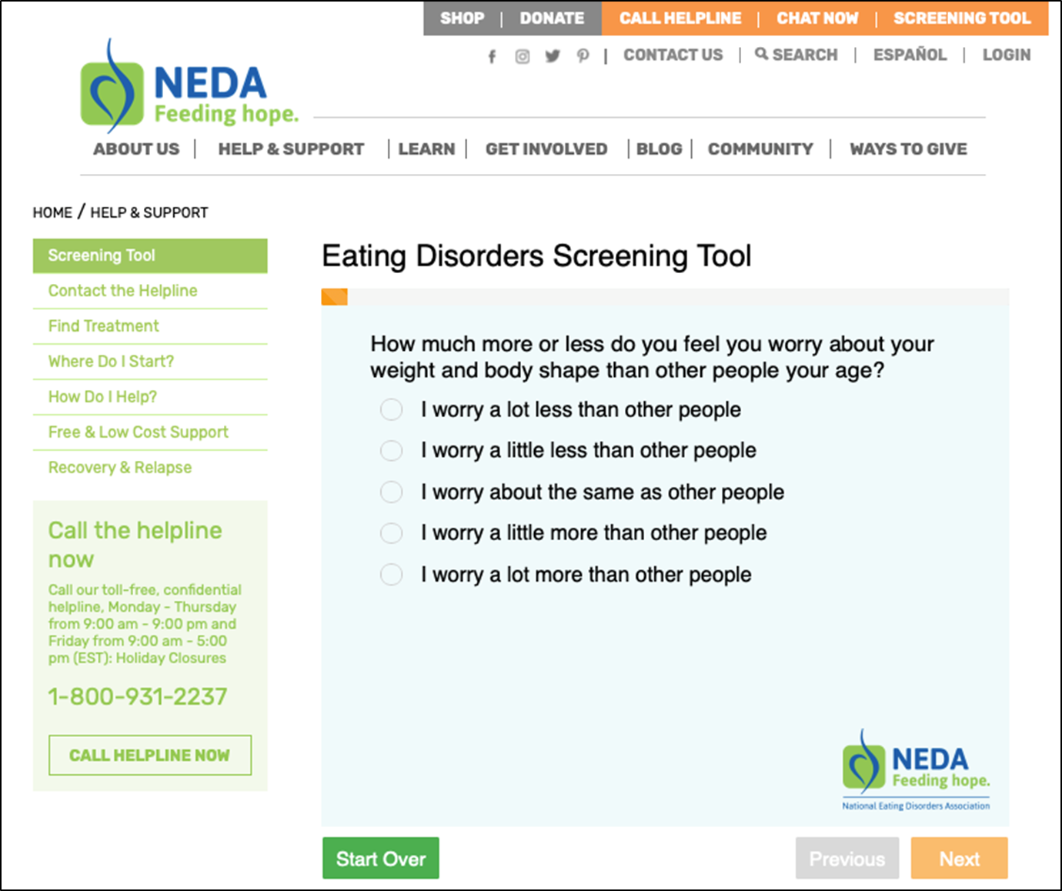
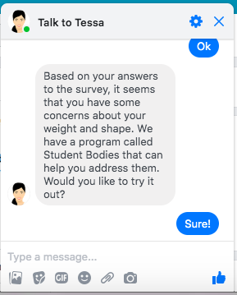
Next Steps: Improving Uptake from Screening Referral to Treatment
Importance of engaging users with support immediately post-screen
Partnered with the National Eating Disorders Association (NEDA) to disseminate evidence-based online EDs screen (SWED)
Over 200,000 respondents per year now take the screen; ~85% screen positive for an ED, and ~85% of those have never been in treatment
Only 12% reported initiating treatment by 2-month follow-up
Developing “chatbot” to increase motivation to seek services and treatment uptake
Fitzsimmons-Craft, Balantekin et al., 2019, Int J Eat Disord; K08 MH120341, PI Fitzsimmons-Craft
Notes:
—> Addresses issue of 3

Slide 25
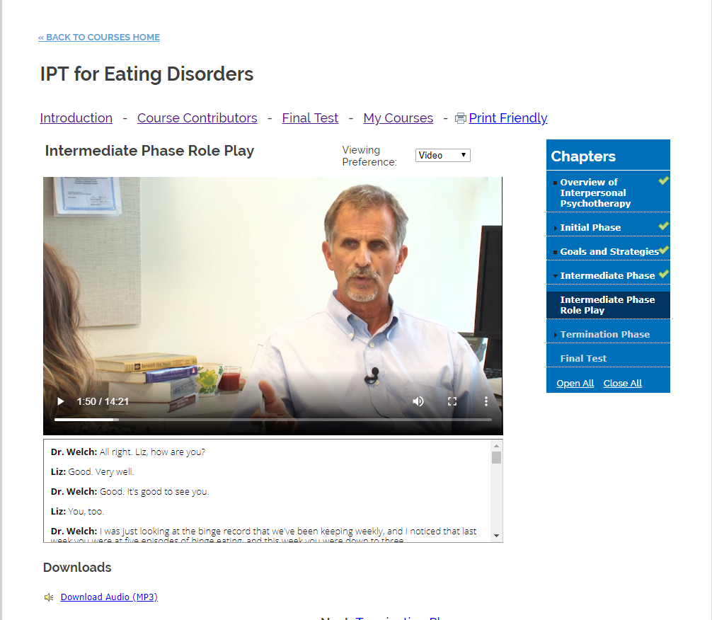
Next Steps: Training the Workforce to Deliver Evidence-Based Treatments
Few clinicians in community practice are using evidence-based treatments, and expert training is costly and time-consuming
Need for highly disseminable training opportunities
Development of comprehensive interpersonal psychotherapy (IPT) online training platform
Resulted in increased fidelity to the treatment, comparable to expert training
NEDA Feeding Hope Fund, PI Wilfley; Shire Continuing Medical Education Grant: 11551, PI Wilfley; Karam et al., in preparation
Notes:
—> addresses issue of 1 - identifying more people -and 2 - treatment gap —> need for multiple treatment options on campuses (mobile, in-person)

Slide 26
Next steps: implementation science
Real-world efforts to implement mental health interventions have often failed
Addressing implementation in the next generation of research:
Plan for implementation from the beginning
Incorporate user-centered design
Focus on sustainability, strategic partnerships
Mohr et al., 2017 J Med Internet Res; Mohr et al., 2018, JAMA Psychiatry
Notes:
Real-world efforts to implement digital mental health interventions have often failed
How to address this in the next generation of research
Creation of programs
Need for user-centered design rather than top-down design; let go of old paradigms
Plan for implementation from the beginning - e.g., plans to address organizational issues, reimbursement, and business models
Design should be iterative and should be built into the life of a digital intervention
Trial methods
Cannot lock down intervention elements; must allow for iteration
Denominator problem - most trials of digital interventions recruit from very large pools of potential participants online, which has biased the evidence based; need to evaluate these interventions in the proposed implementation context
Sustainable implementation
This should be the focus of funded research on digital mental health interventions

Slide 27
conclusion
Online screens can be used to identify university students with EDs and connect them with coached, mobile programs
Given its scalability, a digital CBT guided self-help intervention for EDs has great potential to address the wide treatment gap for this problem
We are making progress toward our goal of offering accessible, affordable, evidence-based care for all individuals with EDs

Slide 28
Thank you!
Denise Wilfley, PhD
wilfleyd@wustl.edu
Ellen Fitzsimmons-Craft, PhD
fitzsimmonse@wustl.edu
FUNDING:
R01 MH100455,PIs Wilfley & Taylor
R01 MH115128, PIs Wilfley, Taylor, Eisenberg, & Newman
K08 MH120341, PI Fitzsimmons-Craft
NEDA Feeding Hope Fund, PI Wilfley
Shire Continuing Medical Education Grant: 11551, PI Wilfley

Slide 29
HBI: Measures
Overall eating disorder psychopathology
Eating Disorder Examination-Questionnaire (EDE-Q Global)
Clinical impairment
Clinical Impairment Assessment (CIA)
Depression
Patient Health Questionnaire-9 (PHQ-9)
Anxiety
Patient-Reported Outcomes Measurement Information System (PROMIS)
Abstinence
No binge eating, vomiting, laxatives/diuretics, or excessive exercise over the past 28 days.

Slide 30
SECONDARY OUTCOME MEASURE: ABSTINENCE
Post: OR=1.48 (0.48, 4.61), p=0.498
Follow-up: OR=1.49 (0.63, 3.52), p=0.368
Notes:
Abstinence from all ED behaviors involves abstinence from binge eating, vomiting, laxative use, and excessive exercise in the past 28 days.
There was not a significant difference between conditions in abstinence from all ED behaviors at post-intervention. For binge eating frequency, there were significantly lower rates in the intervention compared to the control group at post-intervention but not over the follow-up period. For overall combined compensatory behavior frequency, there were significantly lower rates in the intervention compared to the control group at post-intervention and over the follow-up period.

Slide 31
Next Steps: Screening guidelines
Create U.S. Preventive Services Task Force (USPSTF) guidelines for EDs.
Guidelines recommend that clinicians screen and refer patients at risk.
Guidelines ensure there are clinicians at the college health center trained to treat EDs using EBTs.
Lipschitz et al., 2019, J Clin Psychiatry; UPSTF, 2010, JAMA; USPSTF, 2017, JAMA
Notes:
—> addresses issue of 1 - identifying more people -and 2 - treatment gap —> need for multiple treatment options on campuses (mobile, in-person)

